Slide 1
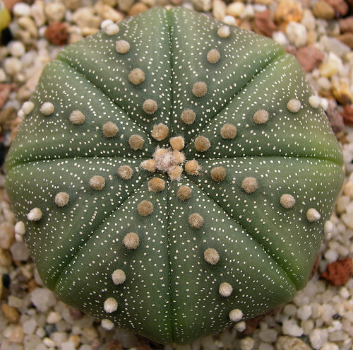
The Plant Body
Chapter 3
Fall 2021

Slide 2
Outline:
Meristems: the plant’s growth centers
Primary growth from apical meristems
Secondary growth from lateral meristems
Cells, tissues, and tissue systems

Slide 3
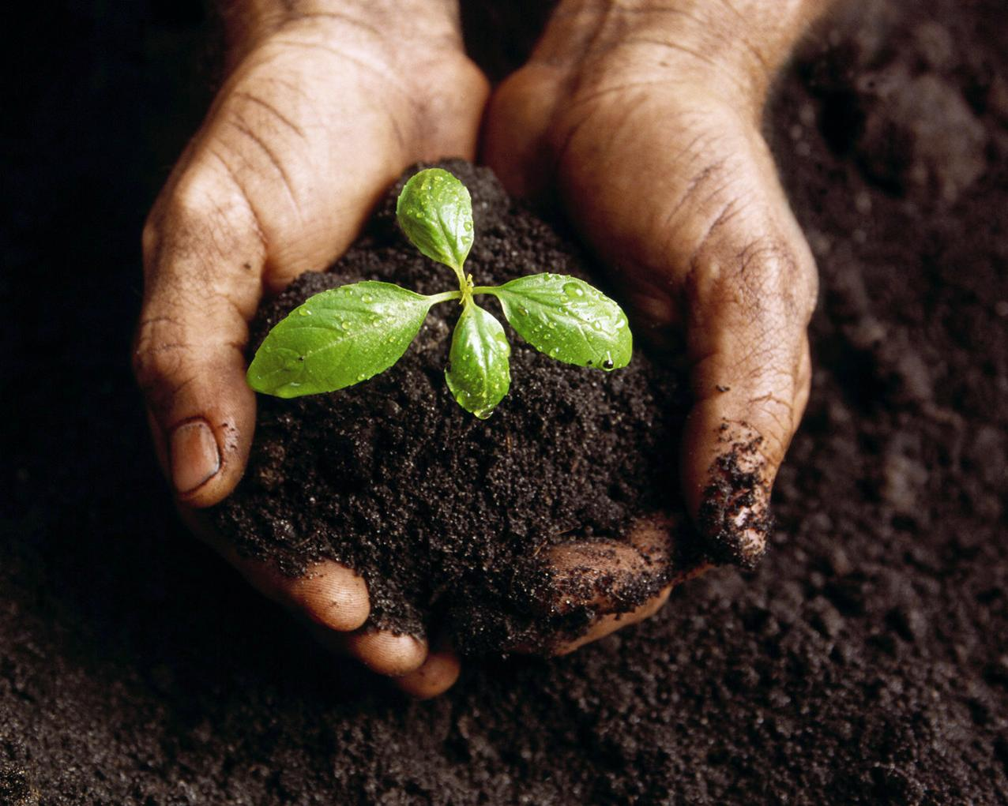
How plants grow:
How Plants Grow:
Meristems
Meristems

Slide 4
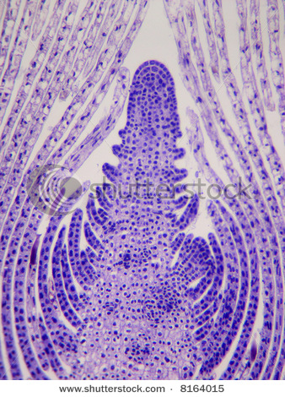
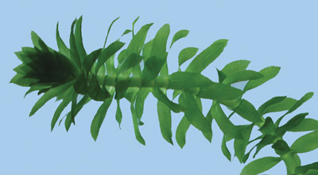
Meristem¹: a region of actively dividing cells, located, for example, at the tip of the root or shoot; the source of new cells and tissues for the growing plant body.
¹From the Greek meristos, divisible
Notes:
Begin here on Thursday

Slide 5
There are two kinds of meristems:
Apical meristems - increase the length of stems and roots
Lateral meristems - increase the girth of stems and roots

Slide 6
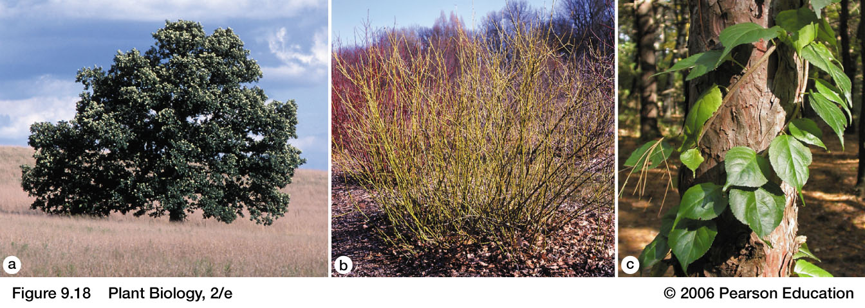
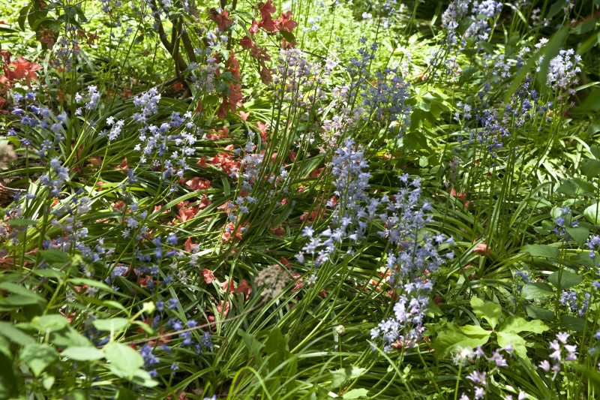
Woody plants have both apical and lateral meristems
trees
shrubs
lianas
Quercus spp.
Cornus spp.
Celastrus spp.
Herbaceous plants have only apical meristems
http://etc.usf.edu

Slide 7
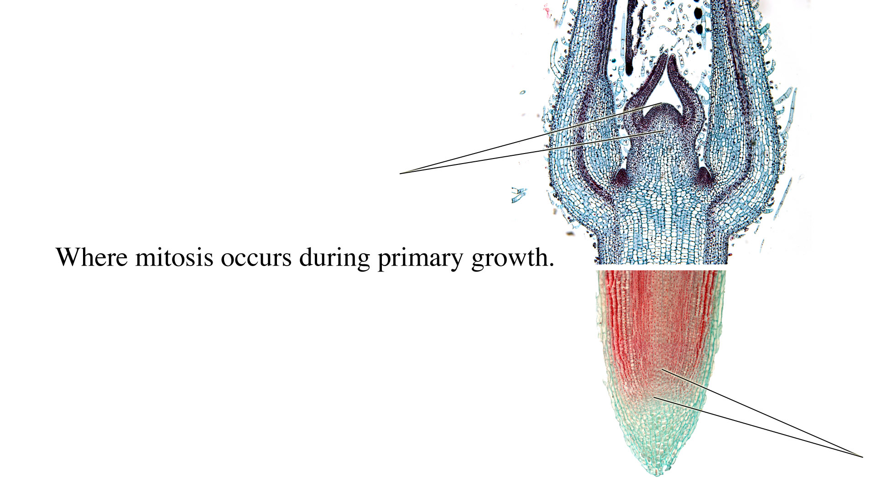
Shoot Apical Meristem, l.s.
Apical dome
Leaf primordium
Axillary bud

Slide 8
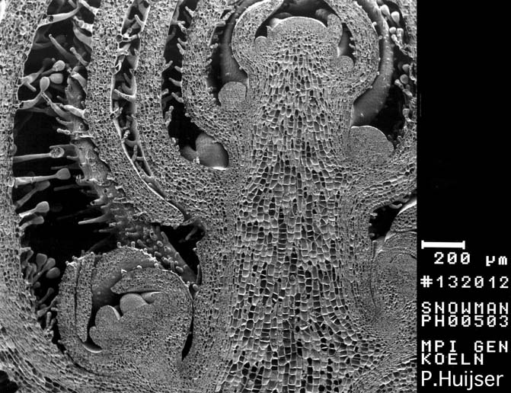
Shoot Apical Meristem

Slide 9
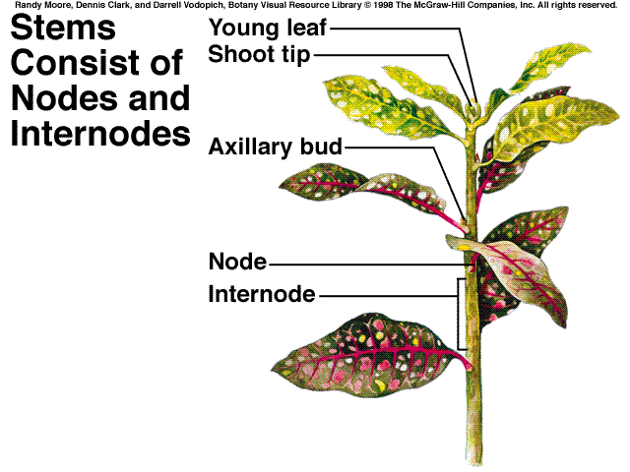
The plant body
is a system of
repeating nodes
and internodes

Slide 10
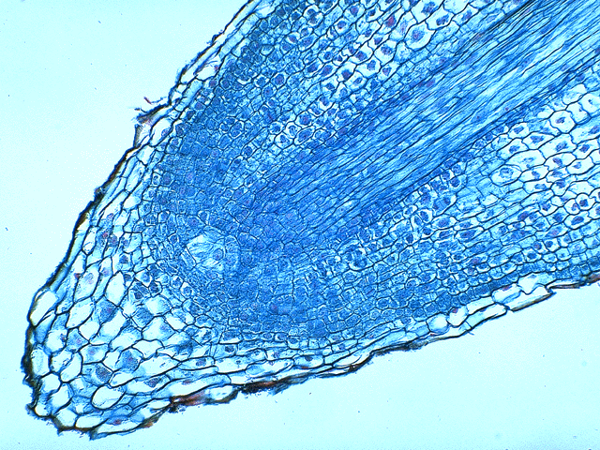
Root Cap
Root Apical Meristem

Slide 11
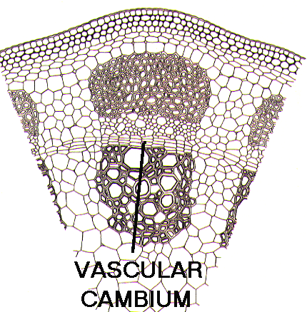
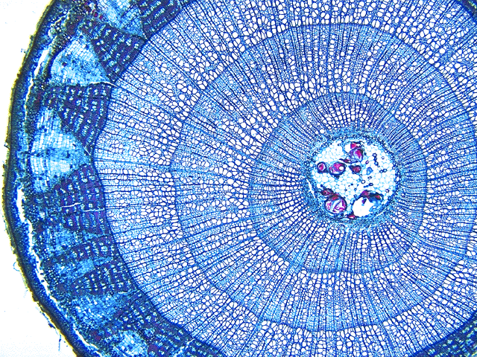
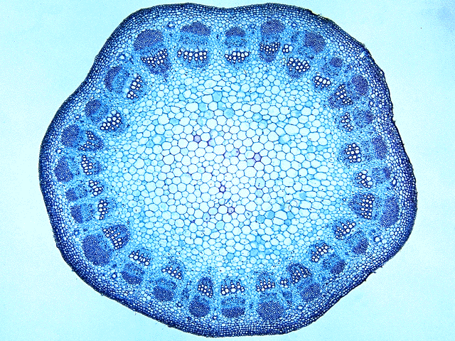
Lateral Meristems
Cell division in the lateral meristems increases the girth of the stem

Slide 13
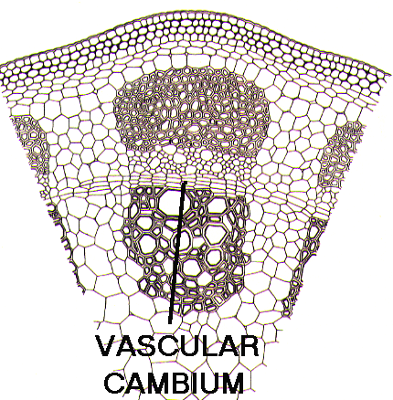
vascular
cambium
The lateral meristem that produces wood is called the
vascular cambium.

Slide 14
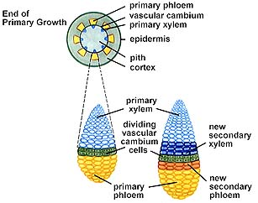
Secondary Growth in a Woody Plant

Slide 15
Secondary xylem
(= wood!)

Slide 16
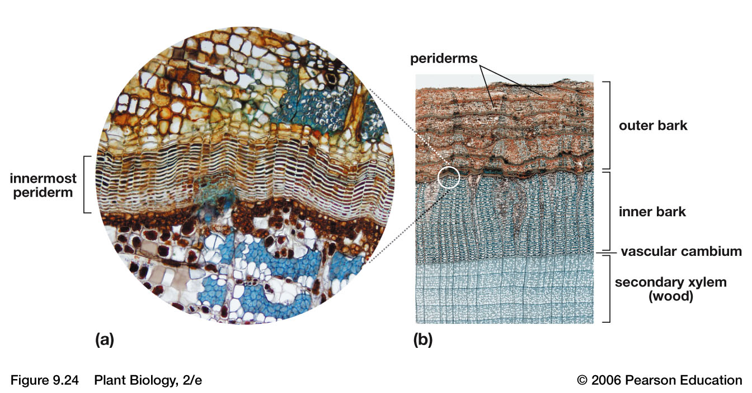
The cork cambium produces cork (outer bark), a tough, thick covering for stems and roots that replaces the epidermis
cork cambium

Slide 17
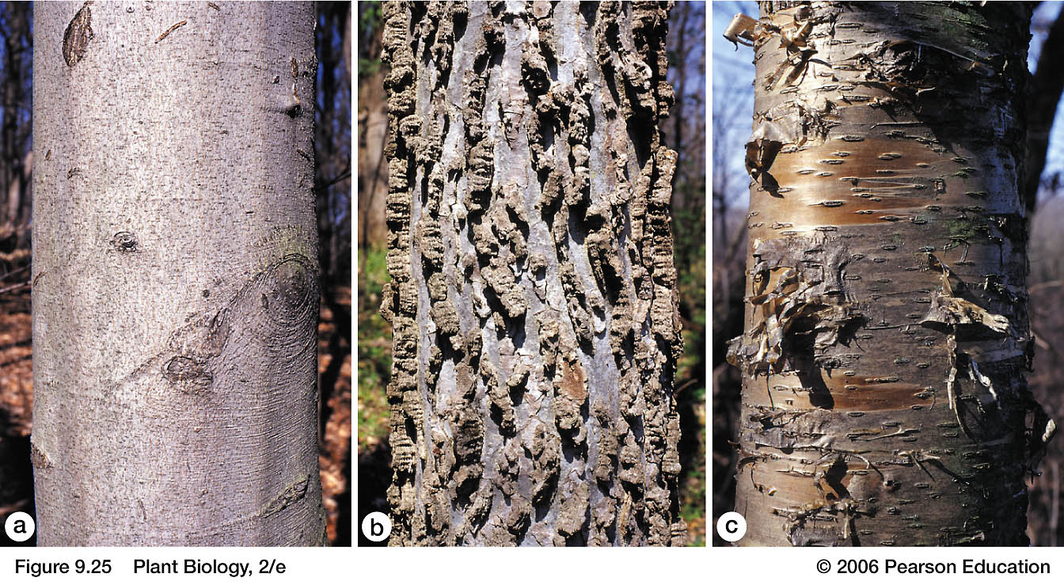
Examples of bark
Fagus grandifolia
Celtis occidentalis
Betula alleghaniensis

Slide 18
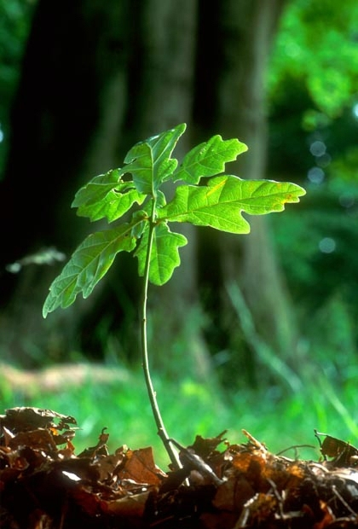
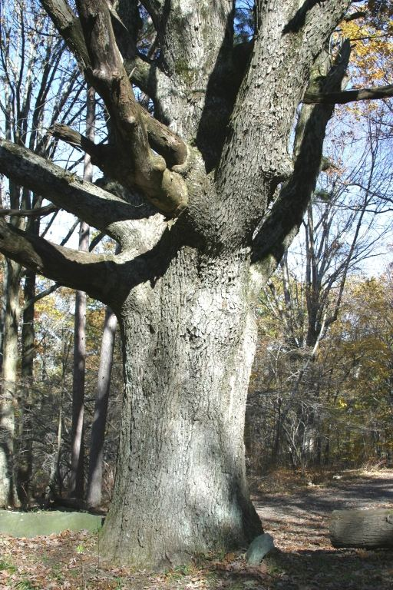

Slide 19
Outline:
Meristems: the plant’s growth centers
Primary growth from apical meristems
Secondary growth from lateral meristems
Cells, tissues, and tissue systems

Slide 20
Hierarchical organization of multicellular organisms (e.g., plants, animals)
cells → tissues → tissue systems → organs → whole organism
e.g., tracheids
e.g., vascular
e.g., angiosperm (flowering plant)
e.g., xylem
e.g., stem

Slide 21
Definitions
Tissues are groups of cells that perform a common function.
Tissues are organized into tissue systems. The three tissue systems are the dermal, ground, and vascular tissues.

Slide 22
Organization of Tissue Systems, Tissues, and Cells
Tis
TTisss
Tissue Systems
Tissues
Notes:
Tissue System: One or more tissues organized into a functional unit connecting the organs of a plant.
Tissue: an ensemble of similar cells from the same origin that together carry out a specific function.

Slide 23
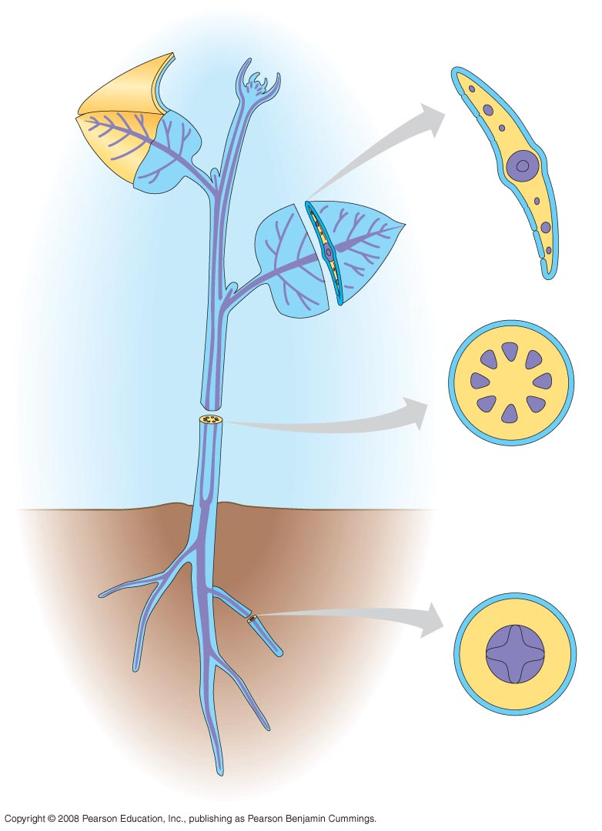
Apical meristems give rise to 3 plant tissue systems:
dermal tissue (outer covering)
ground tissue (storage, photosynthesis, support, etc.)
vascular tissue (transport)
Dermal
tissue
Ground
tissue
Vascular
tissue

Slide 24
Three tissue systems are visible in a stem cross section:
Dermal - the epidermis
Ground - the cortex and pith (if present)
Vascular - the xylem and phloem

Slide 25
Ground tissue
system
Dermal tissue
system
Vascular tissue
system

Slide 26
Pith
Cortex
Ground Tissue System: Cortex and Pith
Cell Type: Parenchyma

Slide 27
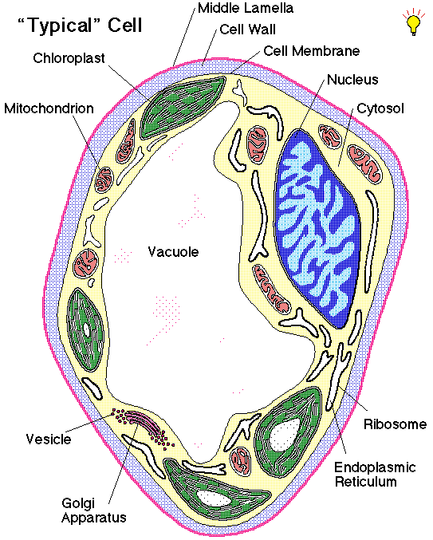
Parenchyma Cells
least specialized
isodiametric
often 14 sided
primary wall of cellulose
no secondary wall

Slide 28
Parenchyma
Collenchyma
Sclerenchyma

Slide 29
Dermal Tissue System: Epidermis
Cell Type: Parenchyma

Slide 30
Vascular Tissue System: Xylem and Phloem

Slide 31
Vascular plants have long-distance transport systems
XYLEM
Water moves from the soil to the atmosphere through the hollow dead cells of the xylem
PHLOEM
Sugars produced in photosynthesis move from the leaves to other parts of the plant body through the phloem

Slide 32
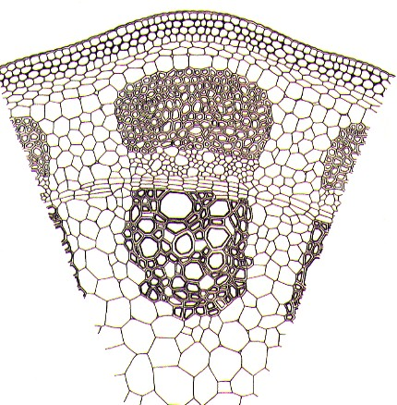
Vascular tissue
xylem

Slide 33
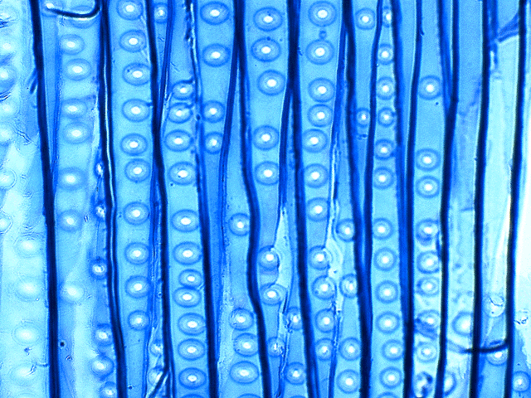
Tissue: Xylem
Cell Type: Tracheary Elements

Slide 34
Tracheary elements:
Are elongate
Have lignified (hardened) secondary walls
Are dead at maturity

Slide 35
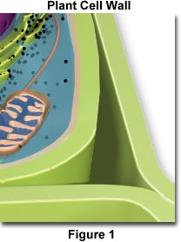
Deposition of the Secondary Wall
Primary wall
Secondary wall
deposited here
Plasma membrane

Slide 36
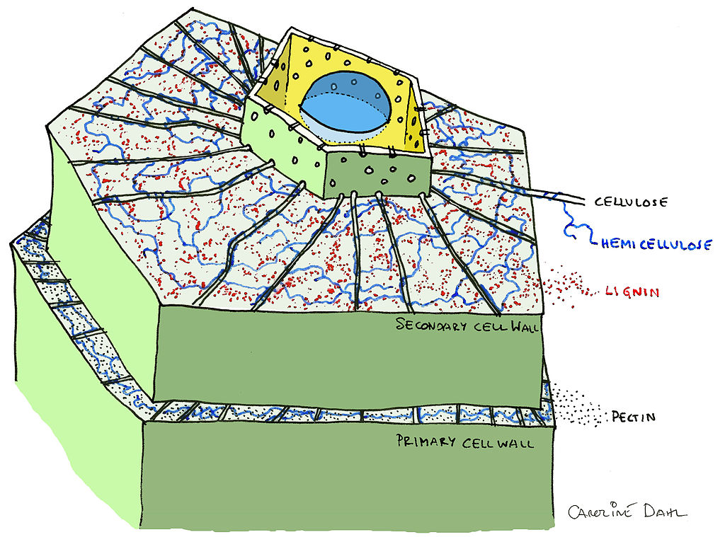
CELL MEMBRANE

Slide 37
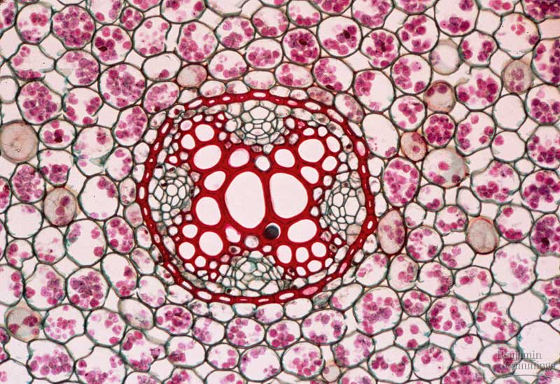
Note the thick,
lignified secondary
walls of the xylem
tracheids.
eudicot root, cross section

Slide 38
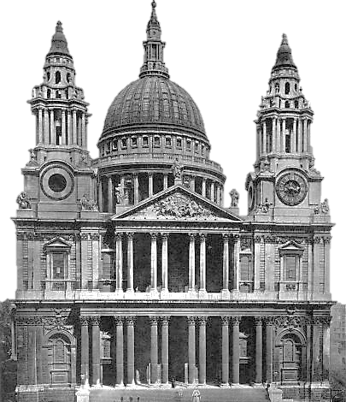
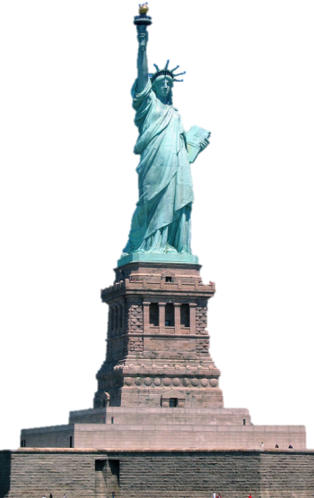
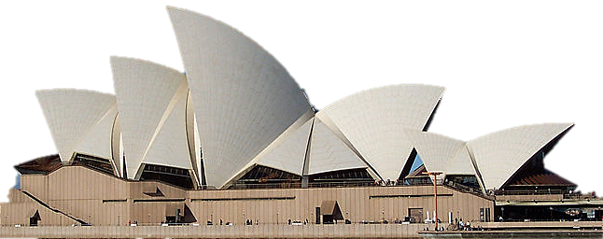
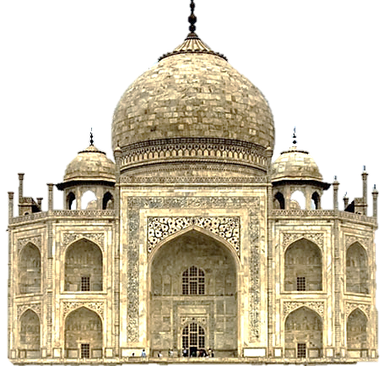
Lignified xylem provides structural support for vascular plants
The tallest living trees tower over many familiar monuments
St. Paul’s Cathedral 111 m
Statue of Liberty 93 m
115 m Sequoia sempervirens
Sydney Opera House 65 m
Taj Mahal 65 m

Slide 39
Vascular tissue
phloem

Slide 40
Sieve Elements:
Are elongate
Primary wall only (no secondary walls)
Living at maturity

Slide 41
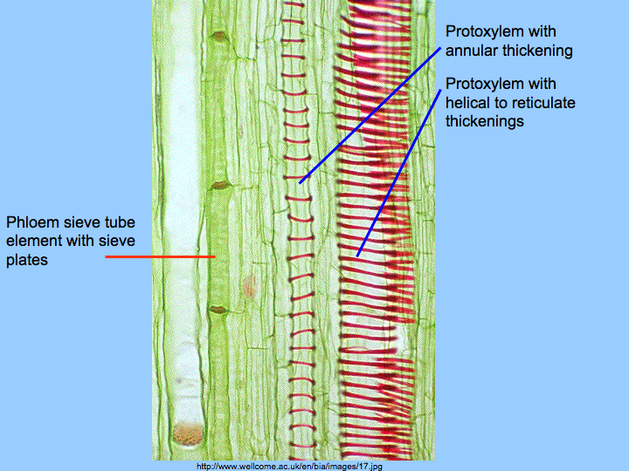
Tissue: Phloem
Cell Type: Sieve Elements
Are elongate
Primary wall only (no secondary walls)
Living at maturity

Slide 42
Outer
bark

Slide 43
Lecture Review, Chapter 3
List the major plant organs and briefly describe the function of each.
How do monocots and eudicots differ in stem, leaf, and root morphology?
Name some familiar vegetables and the part of the plant body that each represents
Define meristem. Compare and contrast the apical meristem and lateral meristem.
What kinds of structures/organs do apical meristems give rise to? Lateral meristems?
What three tissue systems does the apical meristem produce? What is the main function of each?
List the cells types that make up each of the tissue systems.

